Slide 1
3.1: 10, 12, 14, 37, 38, 40
3.2: 29, 30, 31, 32, 35, 36, 43

Slide 2
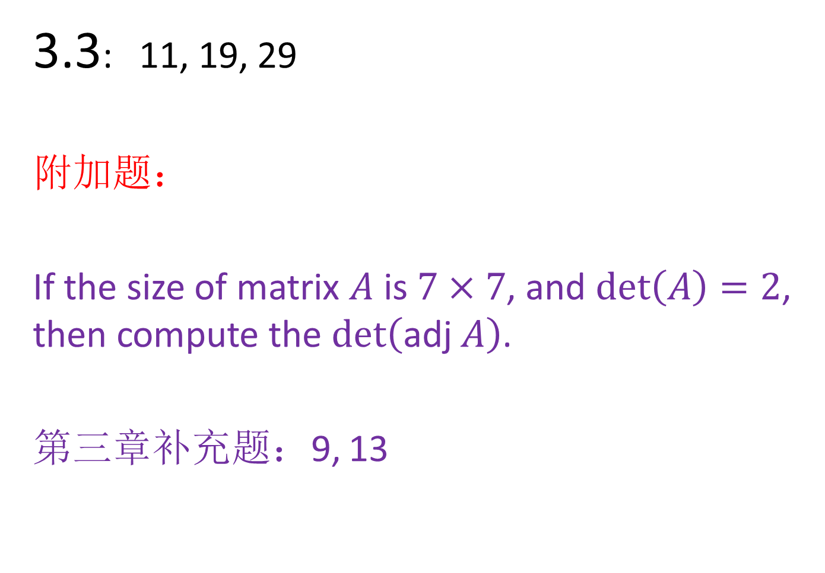
3.3: 11, 19, 29
附加题：
If the size of matrix $A$ is $7×7$, and $det\left(A\right)=2$, then compute the $det\left(\text{adj} A\right)$.
第三章补充题：9, 13

